Slide 1


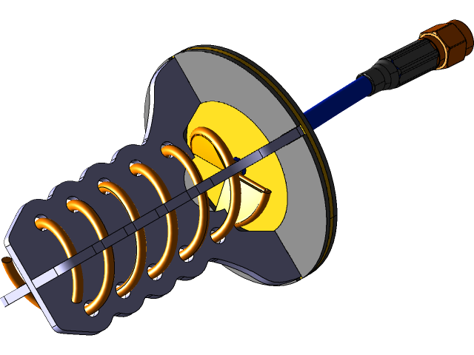
HELICAL ANTENNA
FOR CUBESAT USING CST Tool
Team mrmbers:
Nada Mohamed 202200635 Dolagy George 202200720
Ashar salama 202200199 Malak Mostafa 202202134

Slide 2
PROJECT OBJECTIVES
This project focuses on designing a 2.45 GHz helical antenna for CubeSat applications specifically in the ISM band. using CST Studio Suite. The objective is to achieve high gain, circular polarization, and efficient radiation while ensuring the antenna's electromagnetic emissions comply with IEEE SAR safety limits.

Slide 3

WHY A HELICAL ANTENNA FOR CUBESATS?
VISION
CubeSats requiAre compact, lightweight, and high-performance communication systems.
Helical antennas provide high gain, circular polarization, and directional radiation which is ideal for space links.
2.45 GHz chosen due to its allocation in the ISM/S-band, commonly used for satellite communications.

Slide 4
HOW DOES A HELICAL ANTENNA WORK?
A helical antenna is made of a conducting wire wound in the shape of a helix, like a spring, and mounted over a ground plane. It's usually fed with a coaxial cable. These antennas are popular for satellite and space communications due to their unique radiation properties
When we excite the antenna using a coaxial cable or a two-wire transmission line, current flows through the helical wire. This current generates electromagnetic field lines, which then radiate energy into space. The shape of the helix affects how these fields behave
VISION

Slide 5
HOW DOES A HELICAL ANTENNA WORK?
A helical antenna can operate in two main modes, depending on its physical dimensions and the frequency used."
✅ Normal Mode Occurs when the diameter and pitch (spacing between turns) are small compared to the wavelength.
Radiation pattern: Similar to a dipole (broadside – perpendicular to the helix axis).
Used for: Mobile communication.
✅ Axial Mode
Happens when the diameter and pitch are comparable to the wavelength.
Radiation pattern: Along the axis of the helix (end-fire).
Produces circularly polarized waves, which is great for satellite links.
Used for: Satellite and space communication.
VISION

Slide 6

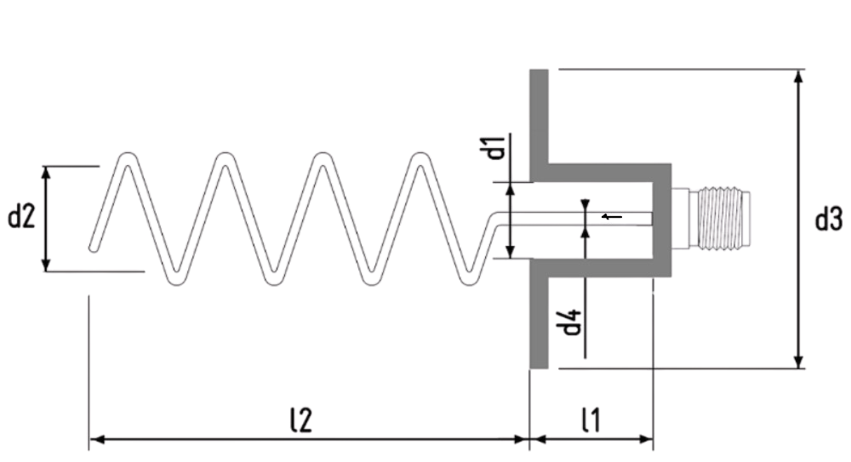
ANTENNA DESIGN
N(Number of turns)=5
D2(Helix Diameter)=2.377 cm
D3(diameter of the shielded enclosure)=10cm
D4(diameter of the central conductor)=2mm
Design Mode: Axial mode (for directional radiation)
Operating Frequency: 2.45 GHz (ISM band)

Slide 7

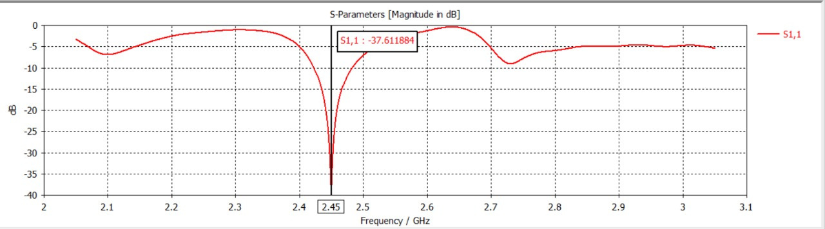
S₁₁ PARAMETER – REFLECTION COEFFICIENT
S₁₁ = -37.6 dB at 2.45 GHz → Very good impedance match, low reflection, efficient energy transfer.

Slide 8

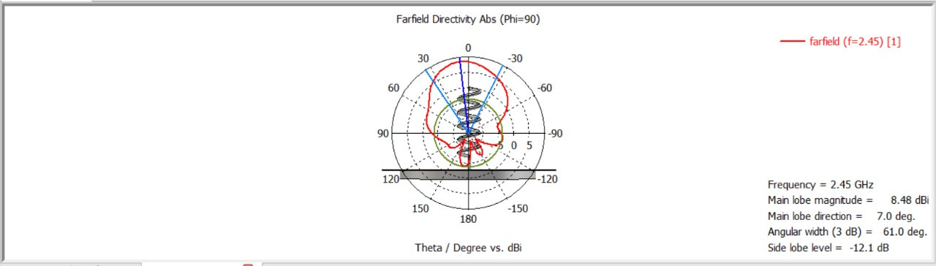
RADIATION PATTERNS AT 2.45 GHz

Slide 9
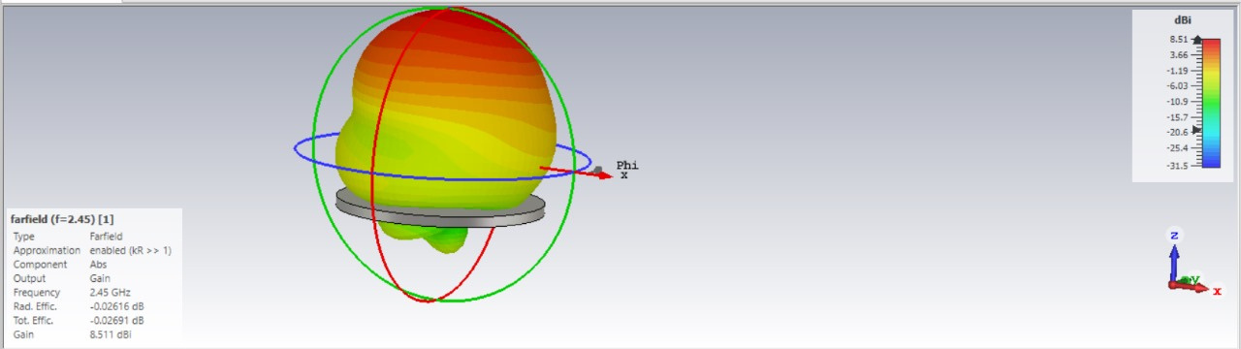
FAR-FIELD RADIATION PATTERN OF A HELICAL ANTENNA

Slide 10
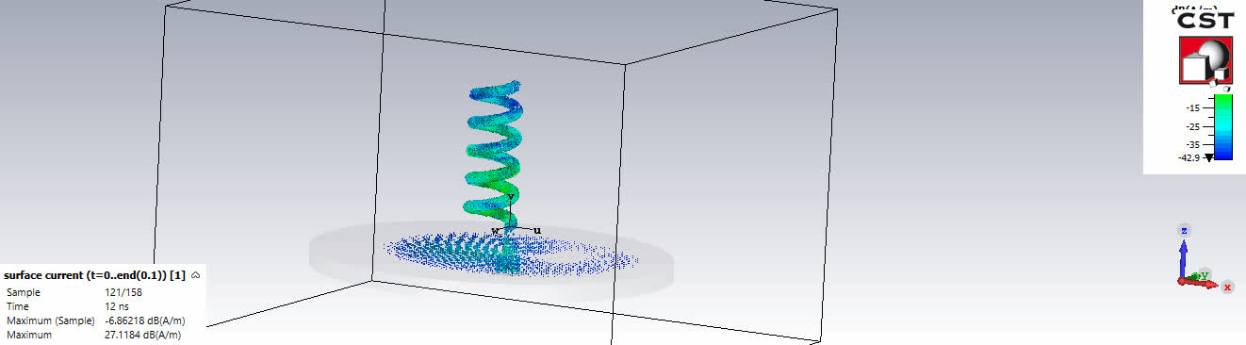
SURFACE CURRENT ANIMATION

Slide 11
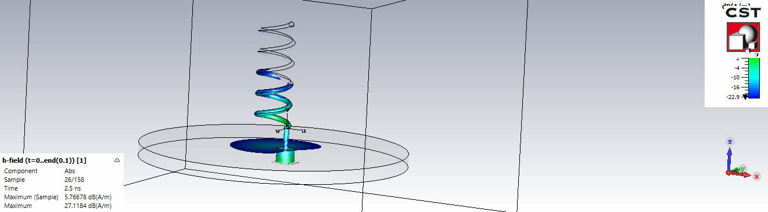
H-FIELD ANIMATION

Slide 12

CONCLUSION
The design and simulation of the 2.45 GHz helical antenna for CubeSat applications demonstrated its suitability for high-performance communication with a gain of ~8.5 dB and circular polarization
1- em power radiated analysis : show well defined main loop in the desired direction
2- low side lobe level
3- axial ratio analysis around 1
4- S11 indicate good impedence
5- antenna input impedance around 50 ohm
6- high bandwidth

Slide 13
REFERENCES
M. C. Rajalakshmi, K. Y. Charan, U. Nandan, and K. S. Rakesh, "Design of Helical Antenna for CubeSat Using CST Tool," Int. J. Creative Res. Thoughts, vol. 12, no. 9, pp. 149–154, Sep. 2024.

Slide 14

THANK YOU

